Slide 1
A Data Analytics Project using Excel & SQL
Name : Harene k
Batch : DADS March 25
Milestone : Project 1

Slide 2
Project Objective
Goal:
Analyze global salary trends based on industry, gender, education , and experience .
Clean and preprocess data for SQL integration .
Create a dynamic Excel dashboard with pivot tables and charts .
Derive key business insights and recommendations.

Slide 3
Dataset Overview
Source:
Cleaned Employee Insights Dataset (28,000+ records)
Attribute | Description
Country, State, City | Work Location
Job Title, Industry | Role and Sector
Annual Salary, Additional Compensation | Base and bonus earnings
Gender, Age Range | Demographics
Highest Education Level | Academic Achievement
Years of Professional Experience | Total and in-field experience

Slide 4
Data Cleaning
Summary Handled missing values (replaced or removed rows).
Standardized job titles, gender, country names . Removed salary outliers using domain knowledge.
Saved cleaned data for SQL upload.
Tools Used: Excel (functions, filters, sorting)

Slide 5
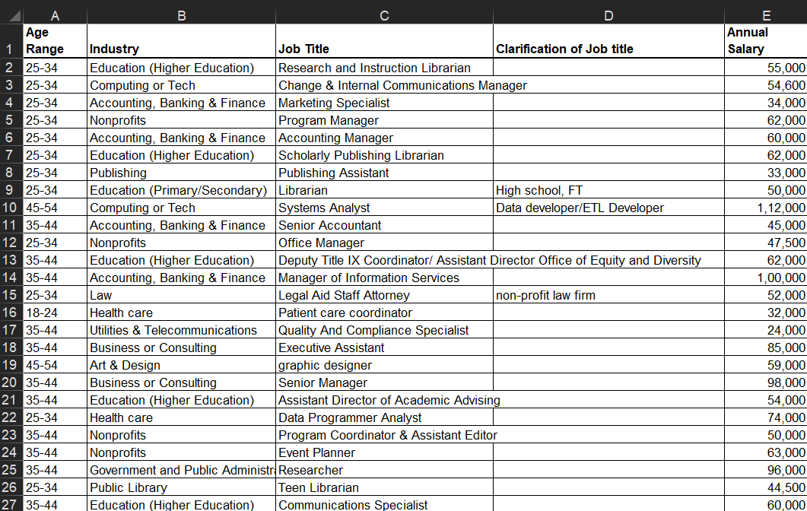
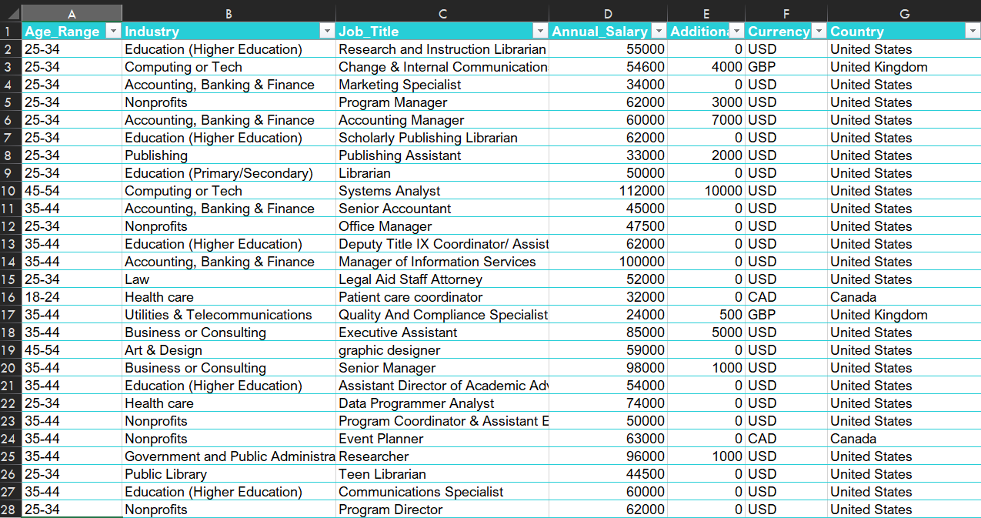
Before cleaning After cleaning

Slide 6
SQL Analysis
Created a MySQL database and imported the cleaned dataset.
Designed table schema to match all attributes.
Executed 10 SQL queries to extract:
  Average salary trends
  Highest paid job titles
  Experience vs Compensation
  Gender-based bonus analysis

Slide 7
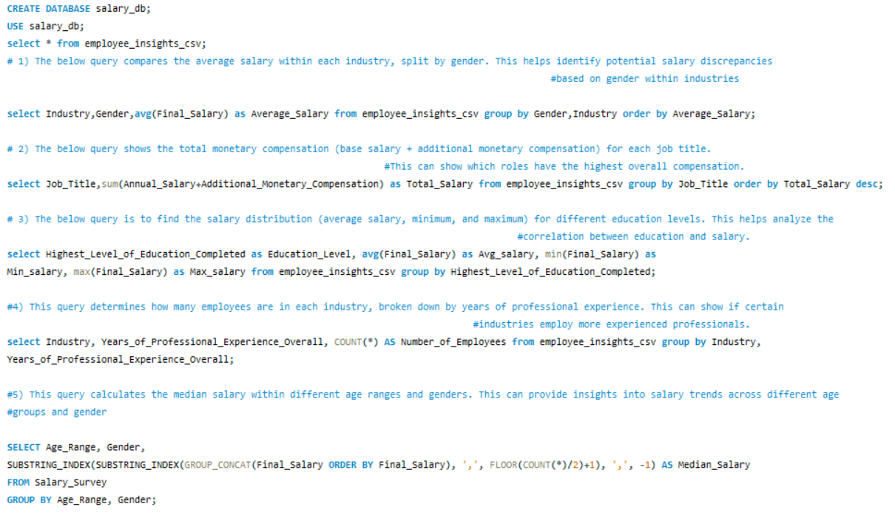
All Quires

Slide 8
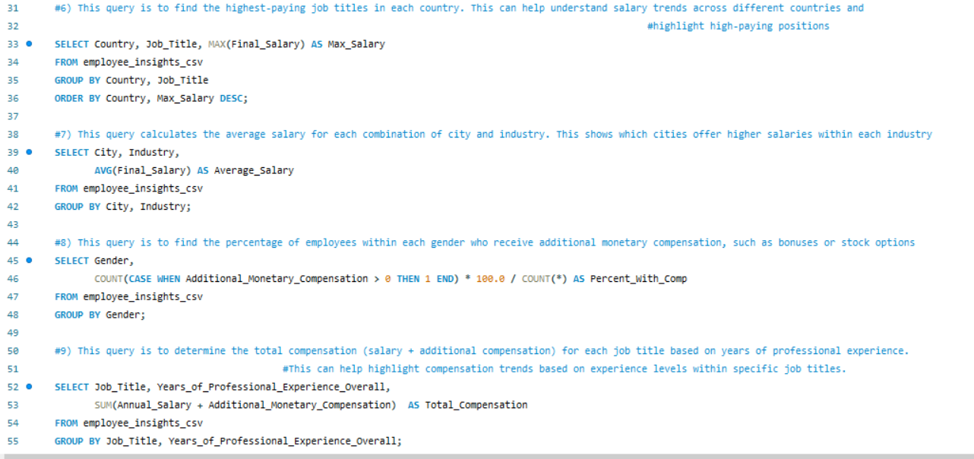
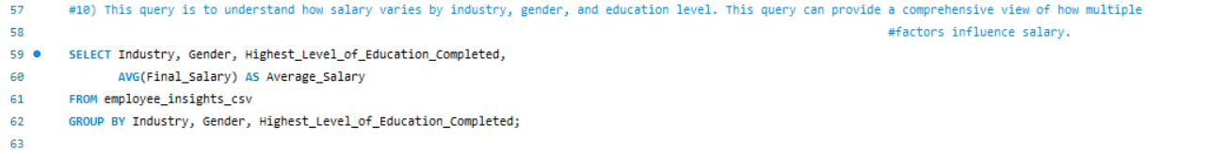

Slide 9
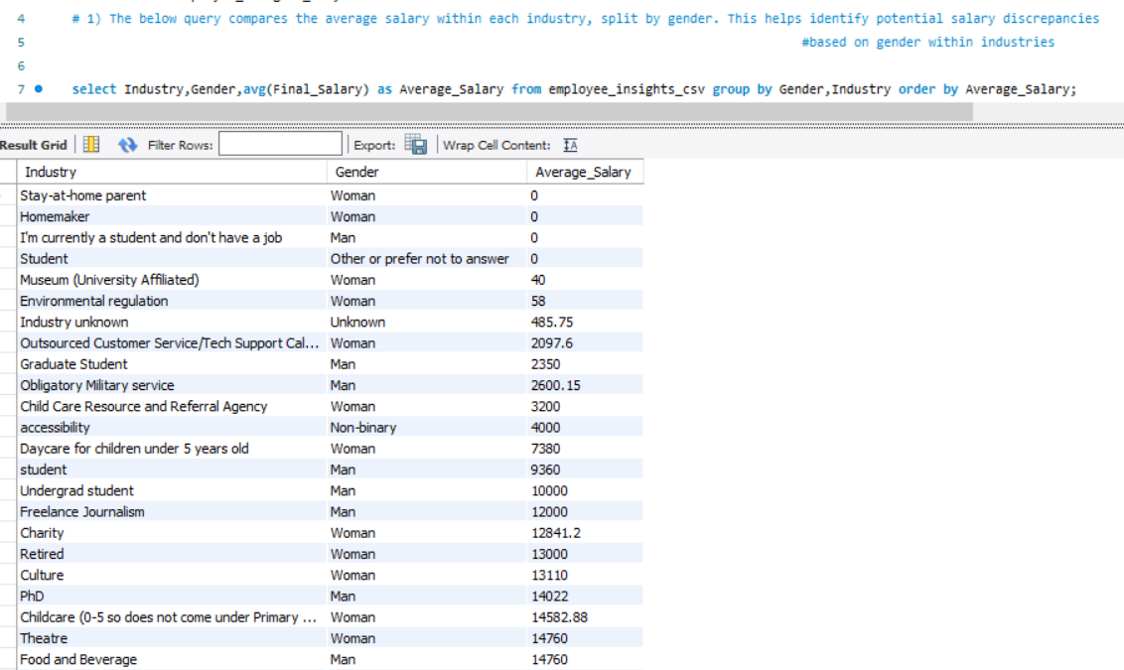
#1 Query

Slide 10
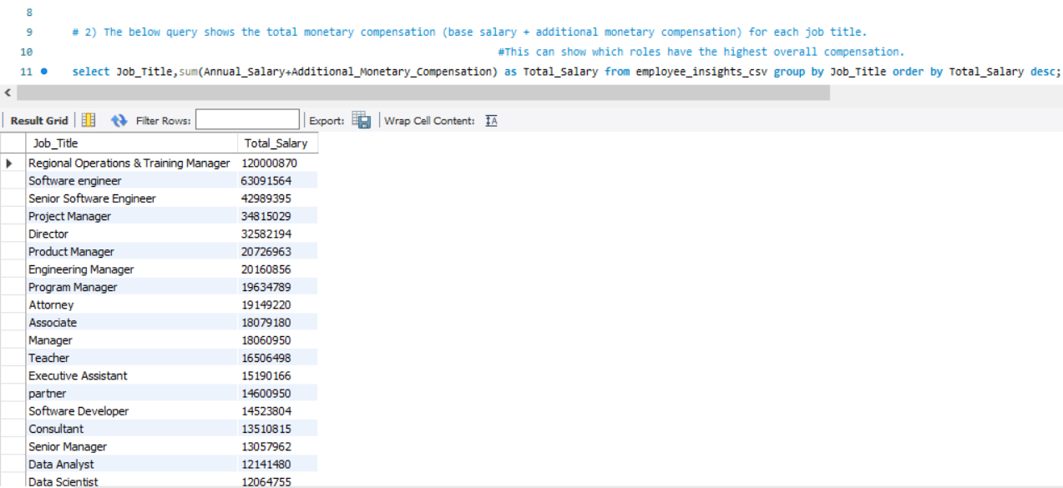
#2 Query

Slide 11
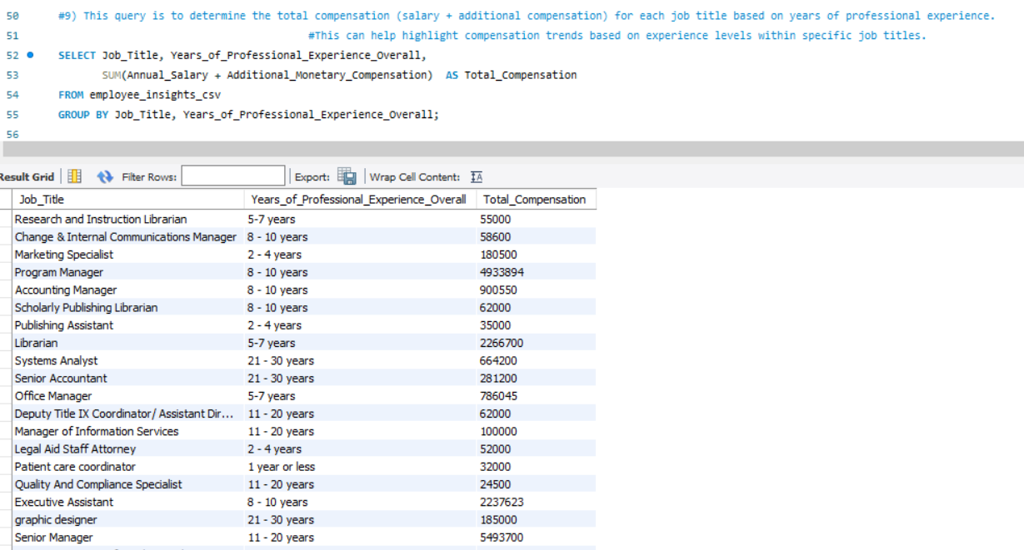
#3 Query

Slide 12
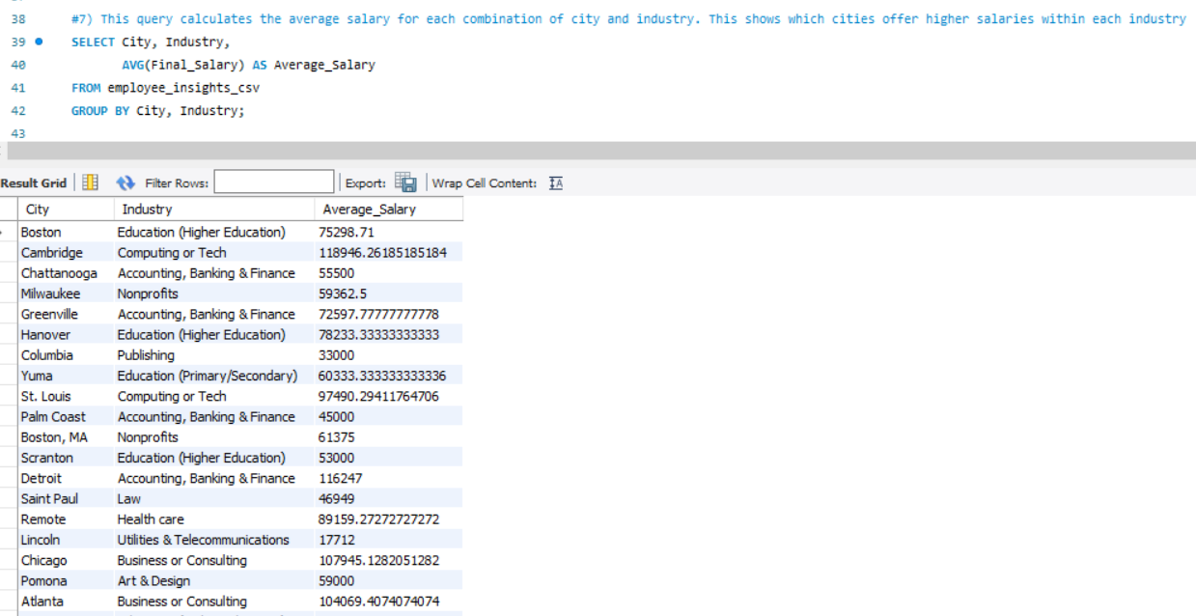
#4 Query

Slide 13
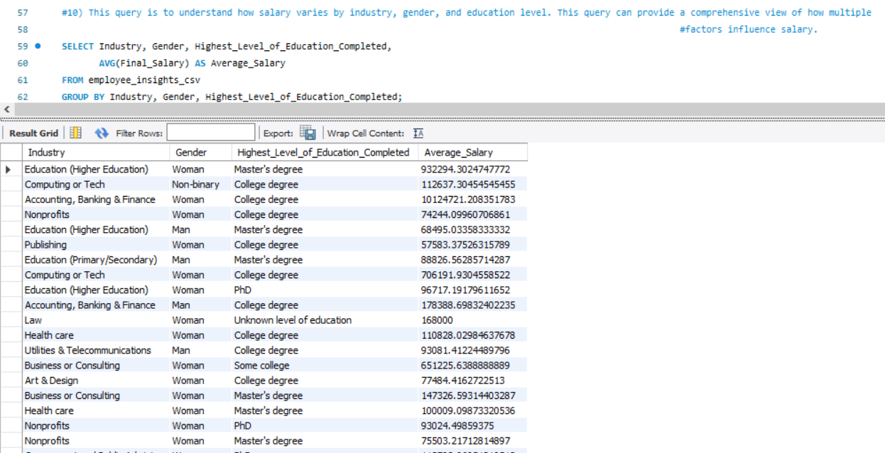
#5 Query

Slide 14
Excel Pivot & Chart Setup
Exported SQL results to separate CSV files.
Imported each into Excel sheets (Q1 to Q10).
Created Pivot Tables for summary metrics.
Inserted charts: Bar, Column, Line, Pie, Treemap.

Slide 15
Key KPIs Identified
KPI | Value
Average Final Salary | ₹7.5 Lakhs
Top Paying Country | Japan – ₹1936 Cr
Most Experienced Industry | Finance
% Employees with Bonus | 42.5%
Highest Paid Job Title | Senior Data Scientist

Slide 16
Dashboard Snapshot
Interactive Excel dashboard combining:
  Salary by industry, gender, job title
  Experience breakdown
  Bonus distribution
Slicers: Gender, Country
Clean, interactive layout

Slide 17
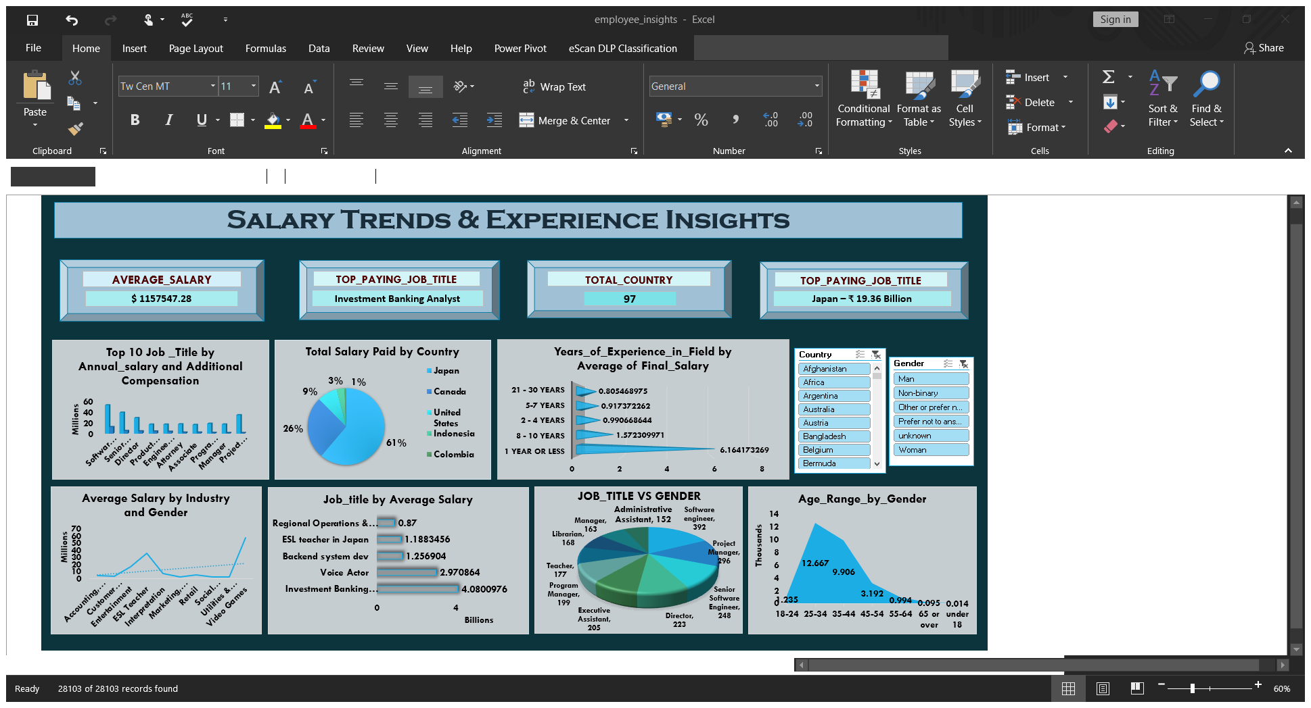

Slide 18
Key Insights & Recommendations
Insights:
Tech & Finance roles dominate top salary ranges.
Salary increases with experience.
Gender pay gap exists in multiple industries.
Recommendations:
Regular salary audits for equity.
Encourage upskilling for high-demand roles .
Focus on employee retention in top-paying sectors.

Slide 19
Conclusion & Learnings
Mastered end-to-end data pipeline: cleaning, SQL, analysis, visualization.
Gained real-world insights into compensation trends .
Excel dashboards proved effective for storytelling.

Slide 20
Thank you!
Any Questions?

